Slide 1
Huron Avenue Reconstruction
April
2024
Asphalt, Sidewalk, Water, Sanitary and Storm Replacement
Notes:
This project is in the draft design phase. The purpose of this initial consultation meeting is to inform residents of the project and obtain feedback related to the design of the project and mitigation of project impacts.

Slide 2
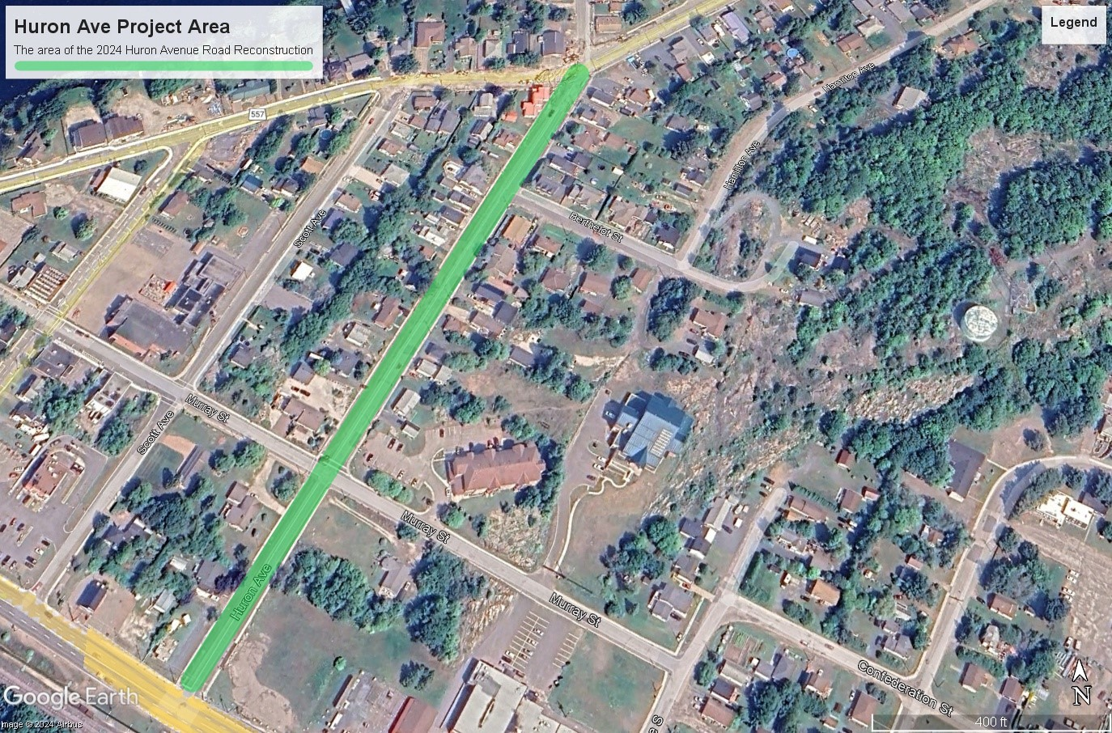
Scope of Project
Notes:
Aging underground infrastructure will all be replaced providing residents with new water, sanitary services and storm water drainage.
This work will tie into the reconstructed area of Woodward Ave and connect to Causley St. with new roadway and sidewalks

Slide 3
Project Components
Asphalt Reconstruction
Sidewalk Reconstruction
Water Main Replacement
Sanitary Sewer Replacement
Storm Sewer Replacement
Installation of new raw water main as part of the ‘Pure Huron’ new water source project
3

Slide 4
Timeline of Project
2024
Woodward Ave to Causley St.
The entire project is planned to be completed this year
Smaller stages of completion and schedule will be available at a later stages of project planning
Notes:
More information related to project phasing and schedule will be made public through the Town of Blind River Website and future Public Consultation Meetings

Slide 5
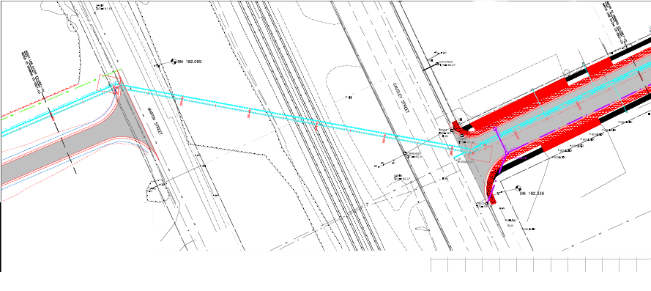
Pure Huron Project
Connecting to Future Work
The raw water intake for the new water source from Lake Huron will be installed while the road is excavated for the Reconstruction.
Additional work is required for completion of the Pure Huron project but it is fiscally efficient to complete this stage during the reconstruction of Huron Avenue
Notes:
This raw water intake line will tie into a LLPS and lake water intake to be constructed in 2025.

Slide 6
Impacts as a Result of the Project
The Town of Blind River will work with local stakeholders to minimize the impacts of the project
The following have been considered
Water Service
Sewer Service
Road closures
School Bus Pickup
Refuse Collection
Canada Post
Parking Solutions and Driveway Access
Notes:
The Town of Blind River will work with local residents and stakeholders to minimize the impacts of the project as much as possible. Your feedback at the end of the presentation is encouraged.

Slide 7
Water Service
No change to residents
Residents will continue to have potable water service to their homes throughout the project
Temporary disruption to service will occur when switching to and from the temporary supply
Notes:
Residents will only experience a temporary loss of water service during the short period required for connecting and disconnecting to the temporary water main.

Slide 8
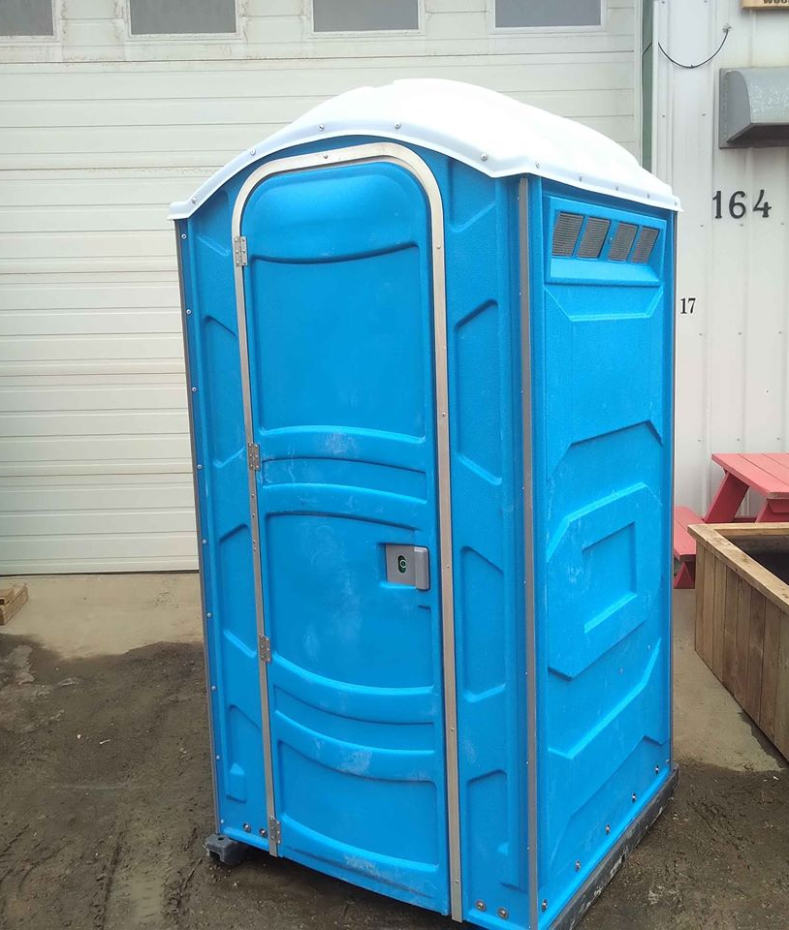
Sewer Service
No change to residents
Residents will continue to have sewer service to their homes throughout the project
Notes:
This work will reconcile sewer system issues that we have started increase in frequency this past year.
Residence will be connected to temporary sewer service prior be being switch to the new sewer main and will not experience disruption of service.

Slide 9
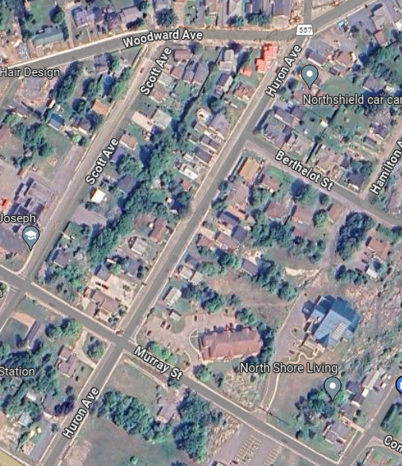
Road Closures
Phased Closures
The project will be completed in smaller phases likely in segments from intersection to intersection
All stakeholders will be consulted to ensure impacts of these closures are minimized
Notes:
These stakeholders include but are not limited to: schools, school bus providers, fire, ambulance and OPP.

Slide 10
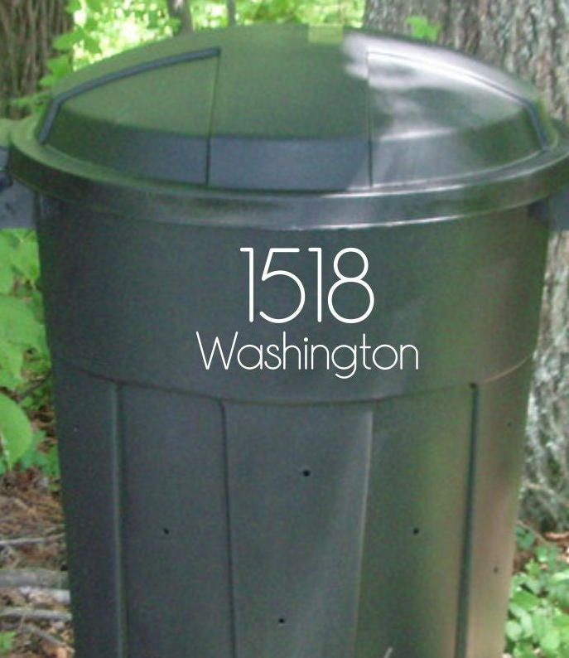
Refuse Collection
No change to residents
Place your waste and recycling at the curb as per normal
Please number your trash and recycling receptacles
Notes:
If your residence is affected in the current phase of work.
Residents are instructed to place their receptacles curbside as they normally would
Contractor will pick up the receptacles and move them to the edge of the roadwork for pick up
Please label your cans and bins for easy return

Slide 11
Canada Post
No interruption to delivery or mail or packages is expected

Slide 12
Driveway Access
Residents will experience a temporary disruption during curb and sidewalk replacement
This will be minimized as much as possible
This access is restricted to ensure longevity of the replaced structures and keep our town (and your property) looking beautiful
Notes:
We understand this will be a significant disruption but we ask residents to be patient for the long-term benefit this will provide.
Don’t forget however, not only will this project enhance the aesthetic appeal of your street, but it will also improve safety and accessibility for all. You'll be able to walk around your neighborhood with ease and enjoy the beautiful scenery without worrying about tripping on uneven pavement. This upgrade will not only benefit you and your family, but also visitors and neighbors who will appreciate the smooth and well-maintained walkways. Please embrace this opportunity for progress and look forward to enjoying the many benefits of the upgraded curbs and sidewalks on Woodward!

Slide 13
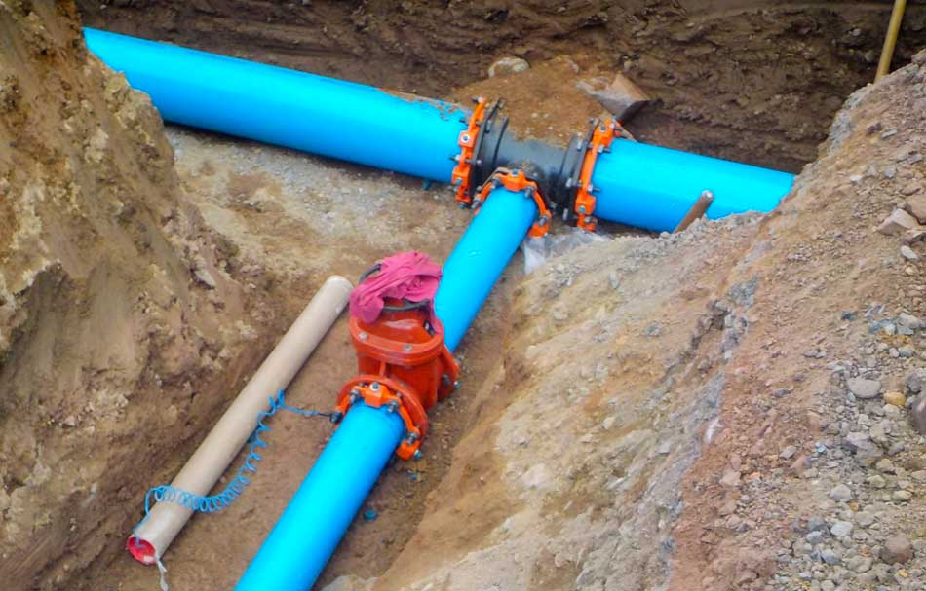
Benefits
New Asphalt Road
Narrowed roadway
Reduced maintenance costs
Safer pedestrian and cyclist travel
New Sidewalks
Improved accessibility
Improved safety
New Underground Services
Reduced risk of service interruption or failure
Raw Water Intake Installation
Reduce total cost of Pure Huron Project

Slide 14
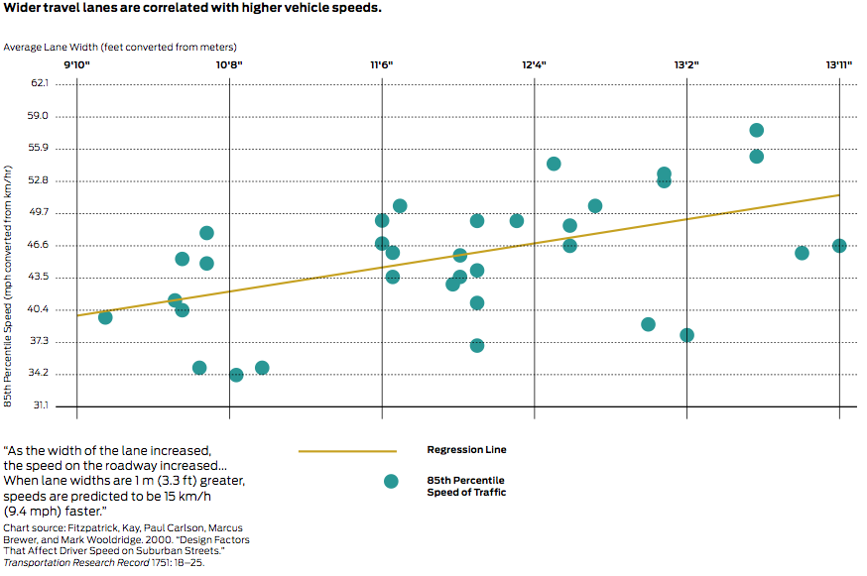
Benefits
Narrower Traffic Lanes = Reduced Speeding
“Narrower Lanes will decrease traffic flow and increase congestions”
Notes:
Wider lanes were once thought to be safer for motorists but studies performed across the globe produce unanimous results with regard to traffic lane width: narrower lanes result in lower speeds and less accidents.
A common misconception is that narrower lanes increase congestion and slow traffic flow but the measured saturation flow rates are similar for lane widths between 10 feet and 12 feet...Therefore, as long as all other geometric and traffic signalization conditions remain constant, there is no measurable decrease in urban street capacity when through lane widths are narrowed up to 10 ft. Appendix A-P, p. A152, Florida Department of Transportation (2007).

Slide 15
Benefits
Reduced Speeds = Safer Roadways
Notes:
At lower speeds the risk of pedestrian death sharply declines further supporting the statement that narrower lanes are safer. When reconstructing a roadway which is used a main pedestrian route for school-age children the safety of the road was one of our main considerations.
Source: Cities Safer by Design (2015)

Slide 16
THANK YOU!
For your time
Questions?
Notes:
Closing Remarks
The replacement of the street is an investment in the future of our community. Upgraded infrastructure can attract new businesses and residents, revitalizing our town and helping to create new opportunities for economic growth. Additionally, the new underground services will reduce the likelihood of service disruptions, meaning you won't have to worry about water, sewer or storm water problems in the future. So, while the temporary disruptions may be inconvenient, it is important to keep in mind that the long-term benefits of the upgraded infrastructure will be well worth it in the end.

